Slide 1
ELEMENTARY STATISTICS, BLUMAN
Confidence Interval Proportion
© 2019 McGraw-Hill Education. All rights reserved. Authorized only for instructor use in the classroom. No reproduction or further distribution permitted without the prior written consent of McGraw-Hill Education.

Slide 2
Objectives for this PowerPoint
How to construct a confidence interval for the estimate of a population proportion
How to calculate the margin of error

Slide 3
Problem
In a clinical study for a pain medication, 26 out of 558 participants experienced dizziness. Find the 90% confidence interval estimate of the proportion of the population that would expect to experience dizziness while taking this particular pain medication.

Slide 4

Sample Proportion
The sample proportion $\hat{p}$ is calculated by dividing the number of sample units that possess the characteristics of interest by the total number of observations or the sample size.
The sample proportion of study participants who experienced dizziness was 26 out of 558.
$$\hat{p}=\frac{x}{n}=\frac{26}{558}=0.0466$$

Slide 5

Point Estimator
The sample proportion is an example of what is called a point estimator. The problem with point estimators is that the likelihood that they are equal to the population parameter that they are intended to estimate is very low. We compensate for this by constructing an interval.
We will calculate a margin of error and add that value to the sample proportion and then subtract it from the sample proportion. This will provide for us a lower and an upper boundary in the form $\hat{p}±E$

Slide 6
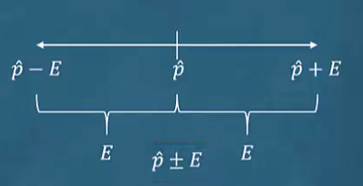

Margin of Error
The margin of error is calculated by the formula E. E is the symbol for the margin of error
$$E=a_{\frac{α}{2}}\sqrt{\frac{\hat{p}\hat{q}}{n}}$$

Slide 7

z Score
We will need to determine an appropriate z score. The symbol $\hat{q}$ represents the complement of p hat. It will be calculated by subtracting the value of $\hat{p}$ from 1.
If we examine the t distribution table, we will see that the bottom row contains z scores. So we will find the column that gives us the probability distribution values for the 90% confidence interval and then on the bottom row locate the value of z.

Slide 8
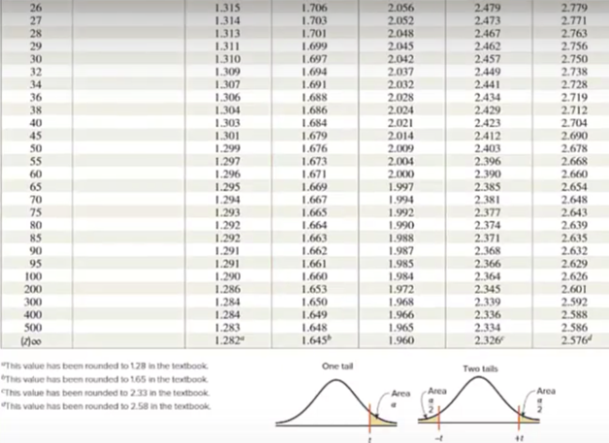
t Distribution Table
The z value is 1.645.

Slide 9

Calculation for Margin of Error
$$E=a_{\frac{α}{2}}\sqrt{\frac{\hat{p}\hat{q}}{n}}$$
$$E=1.645\sqrt{\frac{0.0466∙0.9534}{558}}=0.0147$$

Slide 10

Formula for Confidence Interval for a Proportion
$$\hat{p}−z_{\frac{α}{2}}\sqrt{\frac{\hat{p}\hat{q}}{n}}<p<\hat{p}+z_{\frac{α}{2}}\sqrt{\frac{\hat{p}\hat{q}}{n}}$$
$$\hat{p}=\frac{x}{n}=\frac{26}{558}=0.0466$$
$$E=1.645\sqrt{\frac{0.0466∙0.9534}{558}}=0.0147$$
Left endpoint = 0.0466 - 0.0147 = 0.0319
Right endpoint = 0.0466 + 0.0147 = .0613

Slide 11
Interval in Decimal Format
We have an interval that spans from .0319 to .0613.
We can use this interval as an estimate for the population proportion.
This interval is interpreted in the following way:
It can be stated with 90% confidence that the proportion of the population that would expect to experience dizziness while taking this particular pain medication is between 0.0319 and .0613.

Slide 12
Interval in Percentage Format
We can also interpret this interval in a percentage format.
It can be stated with 90% confidence that between 3.19% and 6.13% of the population would expect to experience dizziness while taking this particular pain medication.

Slide 13
Summary
In this PowerPoint, How to construct a confidence interval for the estimate of a population proportion
How to calculate the margin of error

